Slide 1
Patient/Provider Assignments in Clinigence

Slide 2
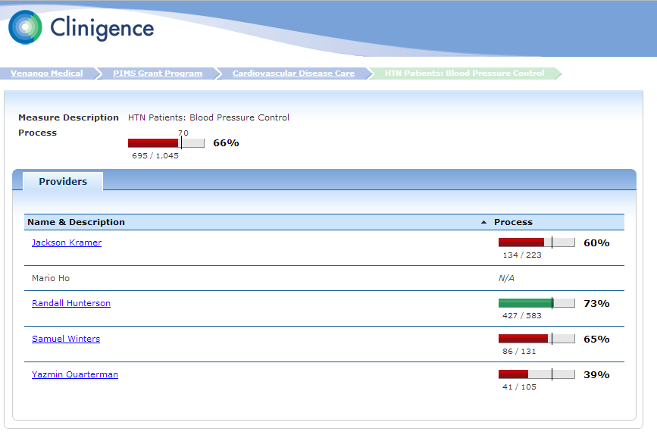
Why Assign Patients to Providers?
Many programs require attestation at the provider level

Slide 3
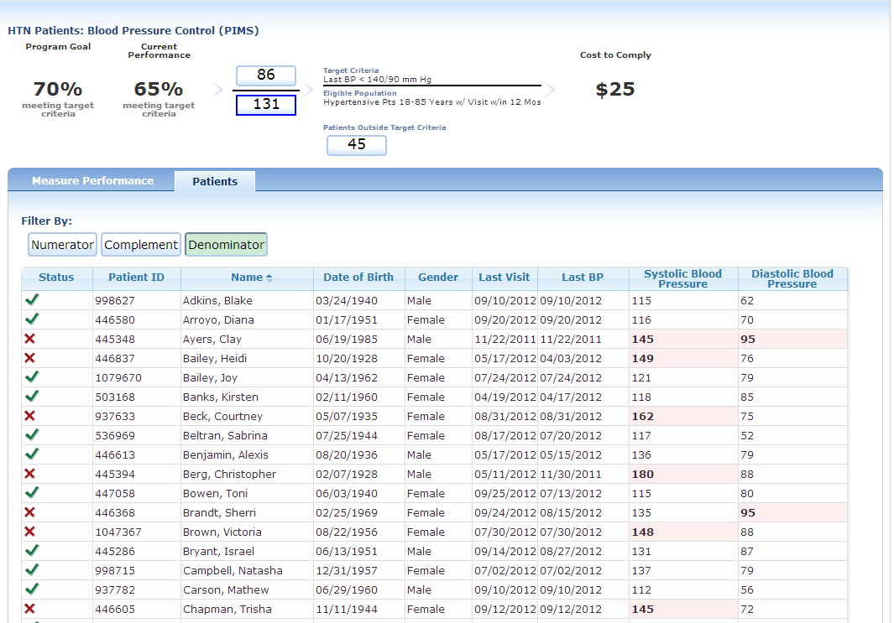
Why Assign Patients to Providers?
Clinigence displays patient lists at the provider level

Slide 4
How Do Patients Get Assigned to Providers?
There are three types of events that create a start date for a new patient/provider assignment:
Explicit Assignment -- The EHR sends a record which explicitly assigns a patient to a specific (primary) provider.
Encounter Assignment -- When the patient has an office visit, the patient is assigned to the population for the provider listed as the encounter owner.
Medication Ordered by -- When a provider orders a medication for the patient, the patient is added to the population for the provider ordering the medication.

Slide 5
How Do Patients Leave a Provider’s Population?
There are three methods used to end a patient/provider assignment:
Mutually Exclusive -- The patient can be in only one provider's population at any time. When any one of the three assignment events occurs, that sets an end date for the previous provider relationship and a new start date for the new provider/patient assignment.
Expiration -- If no new assignment events happen, the patient is removed from the provider's population after a specific period of time.
Explicit Unassignment – In some cases, the EHR will send a record that explicitly unassigns a patient from a specific provider’s population. This setting will always be the same used for Explicit Assignment.

Slide 6
Default Assignment Method
The default options for assigning and unassigning patients are:
Explicit assignment – ON
Encounter assignment – ON
Medication ordering – ON
Mutually exclusive – ON
Expiration – ON (24 months)
Explicit unassignment – ON

Slide 7
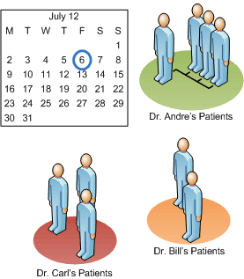
Example – Default Settings
Let’s look at how these default setting work to move patients from one provider’s population to another over several months.
Each patient has a primary provider from the EHR. If there are no other assignment events, the patients remain in the primary provider's population for 24 months.

Slide 8
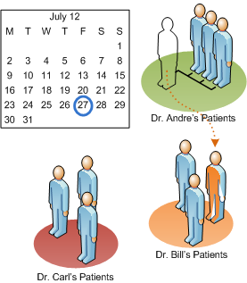
Example – Default Settings
Patient Jane Donner originally had Dr. Andre as primary provider. On July 27, she has an office visit with Dr. Bill. Jane moves from Dr. Andre's population to Dr. Bill's (because of mutual exclusivity). If there are no other assignment events, Jane will remain in Dr. Bill's population for 24 months.

Slide 9
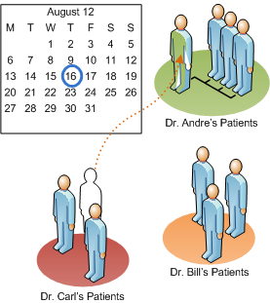
Example – Default Settings
Patient Marco Smith gets a medication refill called in by Dr. Andre on August 16, 2012. Marco moves from Dr. Carl’s population to Dr. Andre’s population. If there are no other assignment events, Marco will remain in Dr. Andre’s population for 24 months.

Slide 10
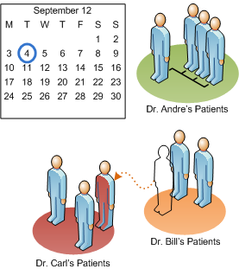
Example – Default Settings
On Sept. 4, the primary provider for Anna Childs changes from Dr. Bill to Dr. Carl. Anna moves from Dr. Bill‘s population to Dr. Carl's population. If there are no other assignment events, Anna will stay in Dr. Carl's population for 24 months.

Slide 11
What Are Your Options?
All three assignment events are turned ON by default. Each practice can decide to turn OFF up to two of those options.
If you want to reduce the frequency of patients being reassigned, you can turn OFF the medication ordering as an assignment event and keep the explicit and encounter assignment options.
If your EHR doesn’t send an encounter owner with each encounter record, you can turn encounter assignment OFF and keep the explicit assignment and medication ordering assignment options.
If you want to keep all the patients with their original primary provider, turn OFF both medication and encounter assignment and keep the explicit assignment option.

Slide 12
More About Encounter Assignments
The default for Encounter Assignment is to create a provider assignment event for each (mapped) office visit.
If you want to reduce the number of times patients are moved from one provider’s population to another, you can create a more restrictive list of encounter types to use to trigger the Encounter Assignment event.
For example, you can specify that the patients are only assigned to a new provider’s population for Well Visits and ignore all other visit types.

Slide 13
More About the Mutually Exclusive Option
The default option for ending a patient/provider assignment is the combination of mutually exclusive and expiration.
Leaving the mutually exclusive setting ON means that a patient can be in only one provider’s population at any time.
Turning the mutually exclusive setting OFF means that a patient will be added to the new provider’s population, rather than moved when an assignment event occurs.

Slide 14
Example – Mutually Exclusive OFF
Let’s look at how these same assignment setting work when the Mutually Exclusive setting is turned OFF.
Each patient has a primary provider from the EHR. Each patient is assigned to his/her primary provider's population for 24 months.

Slide 15
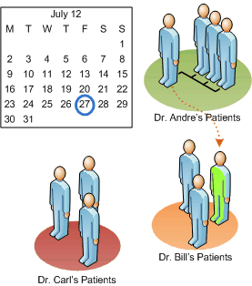
Example – Mutually Exclusive OFF
Patient Jane Donner originally had Dr. Andre as primary provider. On July 27, she has an office visit with Dr. Bill. Jane is added to Dr. Bill’s population and remains in Dr. Andre’s population as well. Jane will stay in Dr. Bill's population for 24 months.

Slide 16
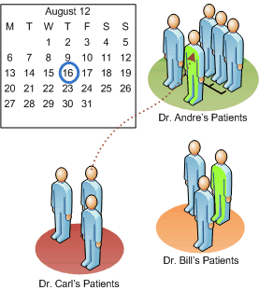
Example – Mutually Exclusive OFF
Patient Marco Smith gets a medication refill called in by Dr. Andre on August 16, 2012. Marco is added to Dr. Andre’s population and remains in Dr. Andre’s population as well. Marco will stay in Dr. Andre’s population for 24 months.

Slide 17
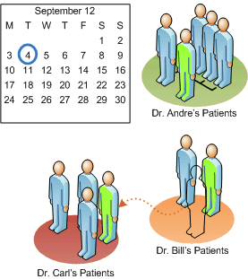
Example – Mutually Exclusive OFF
On Sept. 4, the primary provider for Anna Childs changes from Dr. Bill to Dr. Carl. Anna is added to Dr. Carl’s population and is removed from Dr. Bill’s population because of the Explicit Unassignment option. Anna will stay in Dr. Carl's population for 24 months.

Slide 18
Benefits & Drawbacks
Option | Benefits | Drawbacks
Explicit assignment | If a patient normally sees a particular provider, this method provides a stable patient list for the provider and can make it easy to identify the patients needing an intervention. | In a multi-provider practice, patients don’t always see their primary provider. This can make it difficult to evaluate the actual performance of each provider.

Slide 19
Benefits & Drawbacks
Option | Benefits | Drawbacks
Encounter assignment (often used if Mutual Exclusivity is turned off) | If patients see multiple providers, this method can give a more accurate view of the performance of each provider over a given period of time. | If the encounter list is not restricted, the patient/provider assignment can change frequently. It can require additional coordination at the practice to identify the patients needing an intervention.

Slide 20
Benefits & Drawbacks
Option | Benefits | Drawbacks
Medication order assignment | If the EHR does not send an encounter owner for each office visit, then this method can be used to determine which provider is working with the patient. This method can give a more accurate view of the performance of each provider over a given period of time. | If multiple providers are ordering medications for a single patient, the provider assignment can change frequently. It can require additional coordination at the practice to identify the patients needing an intervention.

Slide 21
Benefits & Drawbacks
Option | Benefits | Drawbacks
Mutually exclusive | Since the patient can only belong to one provider’s population at a time, this method can give a more accurate view of the performance of each provider over a given period of time. | If a patient sees different doctors for different reasons only one doctor will see this patient in the results.

Slide 22
Benefits & Drawbacks
Option | Benefits | Drawbacks
Expiration | By expiring the provider/patient assignment, this ensures that the patient list for each provider is up-to-date. | Depending on the period of time selected for the expiration, patients can fall out of all providers’ populations. When this happens the patient remains in the population count for the practice, but does not appear in the patient list for any particular provider.

Slide 23
Questions to Help You Decide
The patient/provider assignment method you choose will impact the numbers in your reports and the patient lists shown for your providers.
The following questions can help you decide what method will work best for each practice.
Note: The patient/provider assignment configuration must be the same for all providers in the same practice.

Slide 24
Questions to Help You Decide
Question | If yes… | If no…
Do the primary provider assignments in your EHR accurately reflect which provider normally sees each patient? | Leave the default for Explicit Assignment ON and consider turning Encounter and Medication Order Assignment OFF. | Consider turning Explicit Assignment OFF.
Does your EHR send the correct provider as the encounter owner for each office visit? | Leave the default for Encounter Assignment ON – consider supplying a list of encounter types that should trigger a new patient/provider assignment. | Consider turning Encounter Assignment OFF and turning Medication Order Assignment ON.

Slide 25
Questions to Help You Decide
Question | If yes… | If no…
Do you want to reduce the frequency of reassigning or duplicating patients? | Consider turning OFF at least one of the assignment event options – either Encounter or Medication Order. Supply a list of specific encounter types that should trigger an assignment (default is any office visit). | Leave the current default assignment options ON Leave Mutually Exclusive ON.

Slide 26
Questions to Help You Decide
Question | If yes… | If no…
Do you want to allow patients to appear in the patient lists for every provider that has treated him/her in the past 24 months? This gives all providers who have interacted with the patient responsibility for the patient’s care. | Turn Explicit Assignment OFF Leave either Encounter OR Medication Order Assignment ON. Supply a list of specific encounter types that should trigger an assignment (default is any office visit). Turn the Mutually Exclusive option OFF. | Leave the current default assignment options ON Leave Mutually Exclusive ON.

Slide 27
Questions to Help You Decide
Question | If yes… | If no…
Do you want patients to appear in the patient list only for the provider that most recently treated him/her? This gives the provider who most recently interacted with the patient responsibility for the patient’s care. | Turn Explicit Assignment OFF Leave either Encounter OR Medication Order Assignment ON. Supply a list of specific encounter types that should trigger an assignment (default is any office visit). Leave the Mutually Exclusive option ON. | Leave the current default assignment options ON Leave Mutually Exclusive ON.

Slide 28
Questions to Help You Decide
Question | If yes… | If no…
Do you want one provider to take ownership for the patient’s care, regardless of which provider sees that patient? | Turn Explicit Assignment ON. Turn Encounter and Medication Order Assignment OFF. Leave the Mutually Exclusive option ON. | Leave the current default assignment options ON Leave Mutually Exclusive ON.

Slide 29
Questions to Help You Decide
Question | If yes… | If no…
Do your providers wish to be able to monitor a fairly stable list of their patients? | Turn the Mutually Exclusive option OFF. | Leave the default for Mutually Exclusive ON
Do you want to eliminate any duplication of patients in the denominator counts and patient lists? | Leave the default for Mutually Exclusive ON. | Consider turning the Mutually Exclusive option OFF.

Slide 30
Select Your Patient/Provider Assignment Method
Select at least one (1) assignment option:
Explicit assignment (primary provider)
Encounter assignment List encounter types that you want to trigger a new assignment: ______________________________ ________________________________________
Medication assignment
Select the assignment end option(s):
Mutually exclusive
Expiration Specify time period: ________________
Explicit Unassignment (must be the same as Explicit Assignment above)

